Slide 1
CS- Computer Vision
Anwar Khan
Department of Computer Science University of Lahore
Notes:
https://introtocv.github.io/materials.html
Top computer vision conferences and papers:
CVPR: IEEE Conference on Computer Vision and Pattern Recognition
ICCV: International Conference on Computer Vision
ECCV: European Conference on Computer Vision
NeurIPS: Neural Information Processing Systems

Slide 2
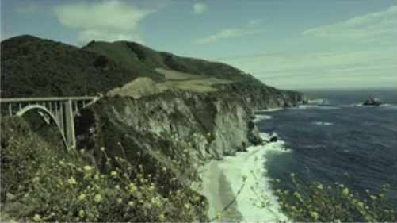
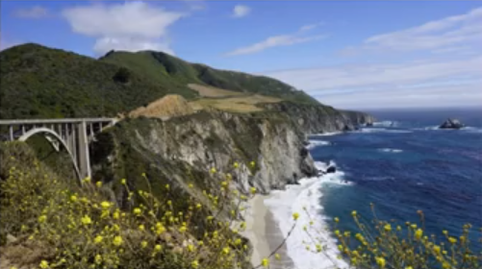
Computer Vision vs Image Processing
Image Processing

Slide 3
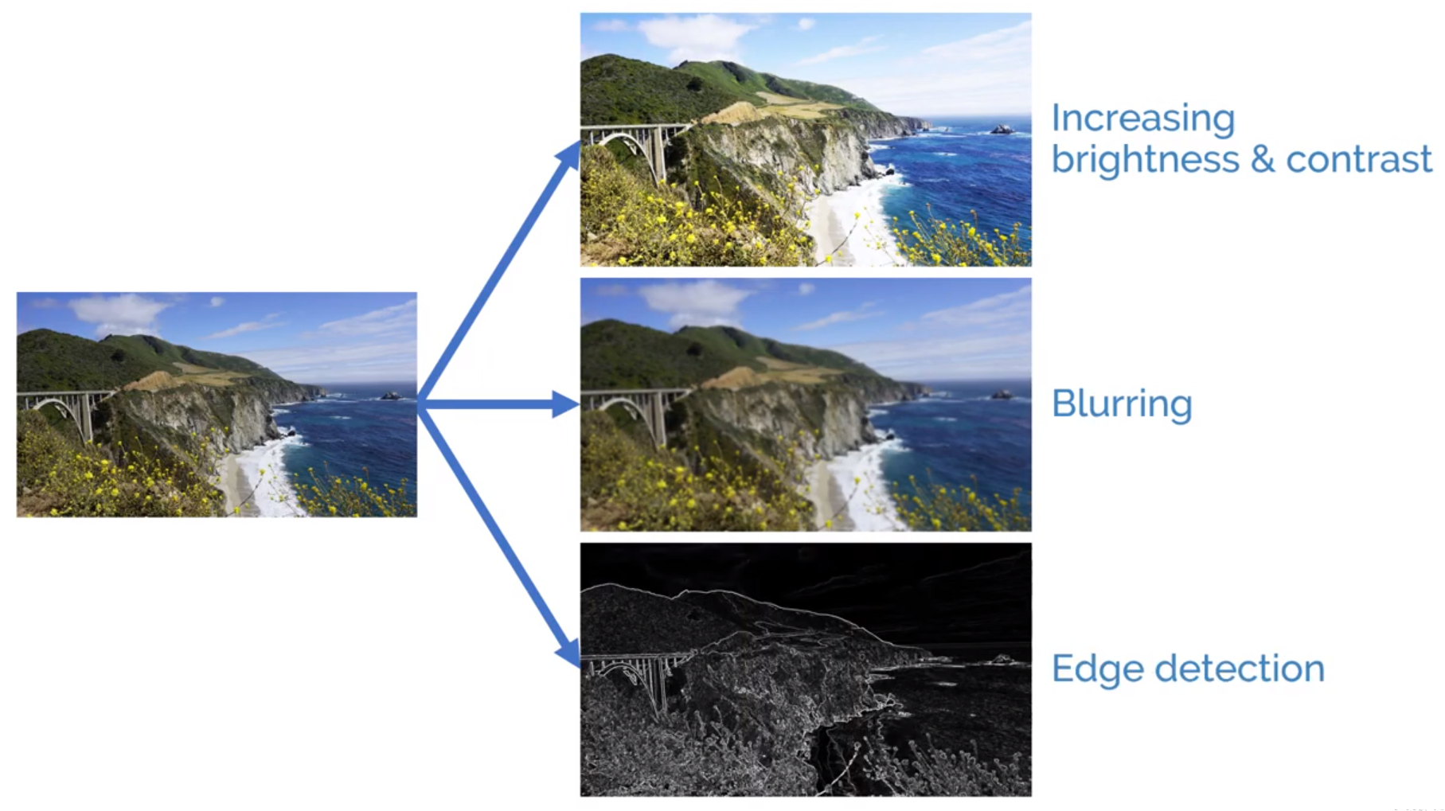
Image Processing

Slide 4
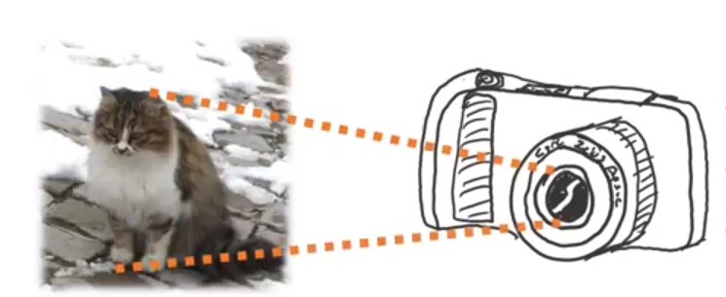
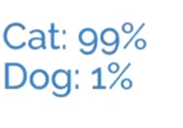
Computer Vision
This is about scene or image understanding.
Output
Input
Notes:
Here output can be a vector of number, strings or anything that helps in understanding contents of the input image.

Slide 5
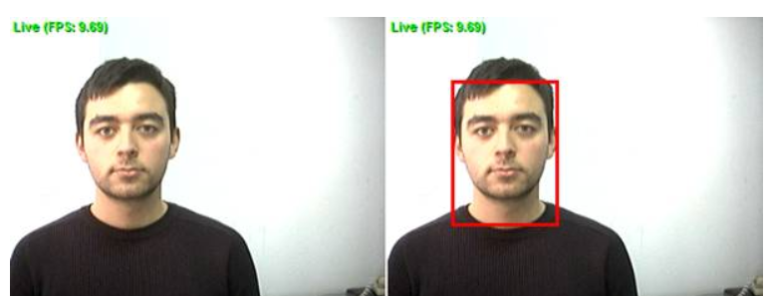
Computer Vision
Another Example: Face detection
Input
Output: Four coordinates
Notes:
Here output can be a vector of number, strings or anything that helps in understanding contents of the input image.

Slide 6
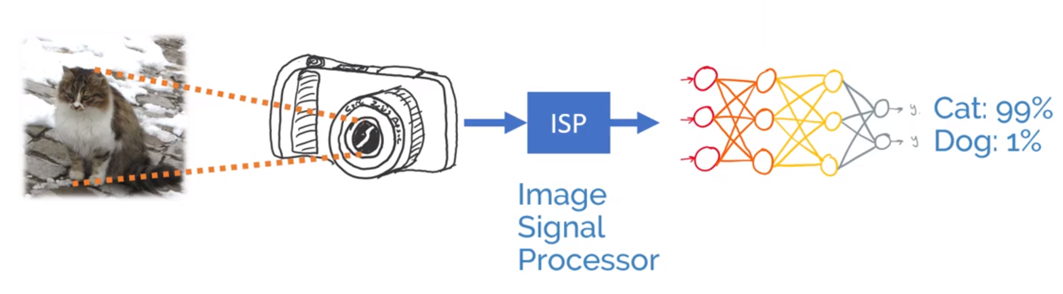
Image Processing + Computer Vision
An ISP located inside camera usually converts raw signals from photodiodes
into a matrix that can be visualized as an image.
Notes:
https://en.wikipedia.org/wiki/Image_processor

Slide 7
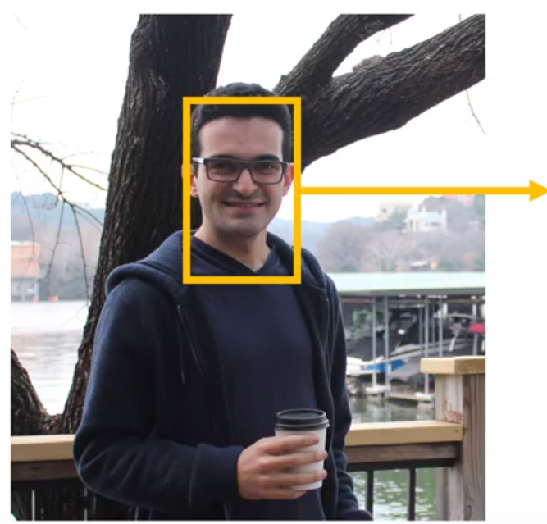

Computer Vision + Image Processing

Slide 8
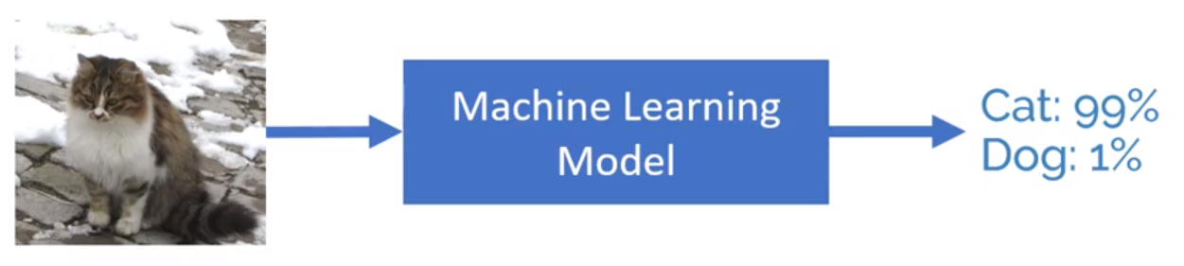
Machine Learning in Computer Vision
Computer vision algorithms can also use machine learning models to learn the arithmetic models for scene description.

Slide 9
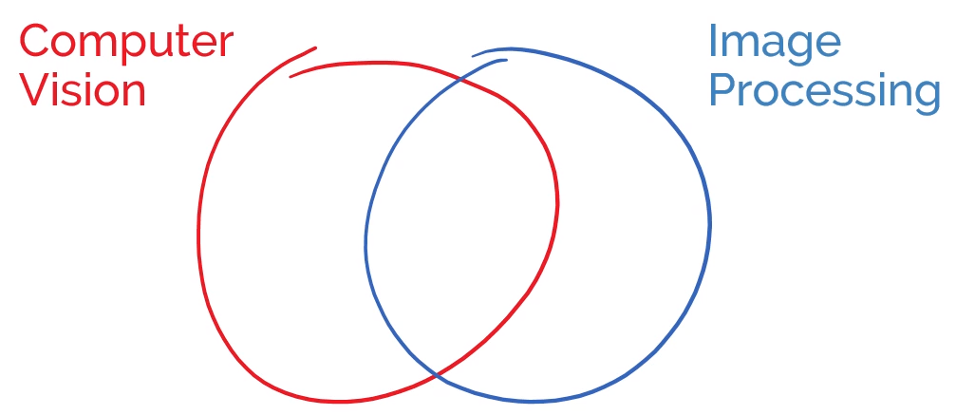
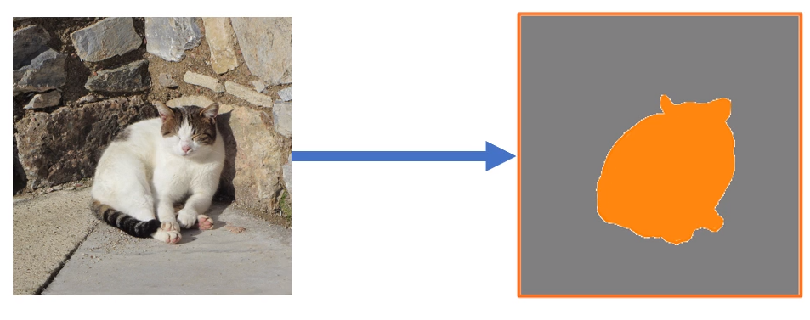
Computer Vision or Image Processing?
Semantic
Segmentation

Slide 10
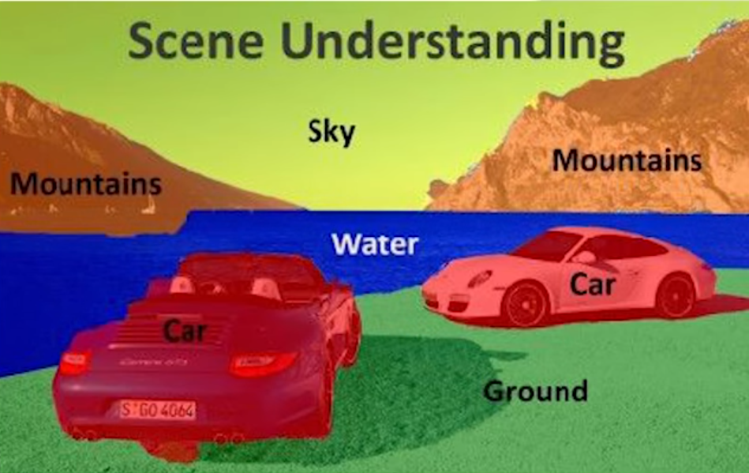
Computer Vision or Image Processing?
Semantic Segmentation

Slide 11
Computer Graphics vs Computer Vision
Computer Graphics and Computer Vision represent two processes of reverse inference.
In CV, input is an image, output is its description, i.e., we get to know about the real world represented in that image.
In CG, this process of inference is reversed. Here we assume that the description of the real world is already known, we just want to create a 2D snapshot of that world.

Slide 12
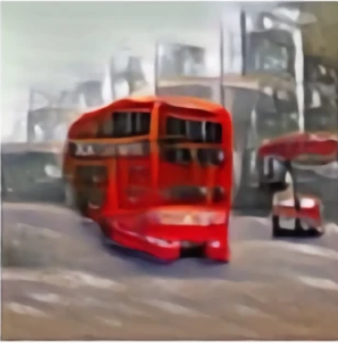
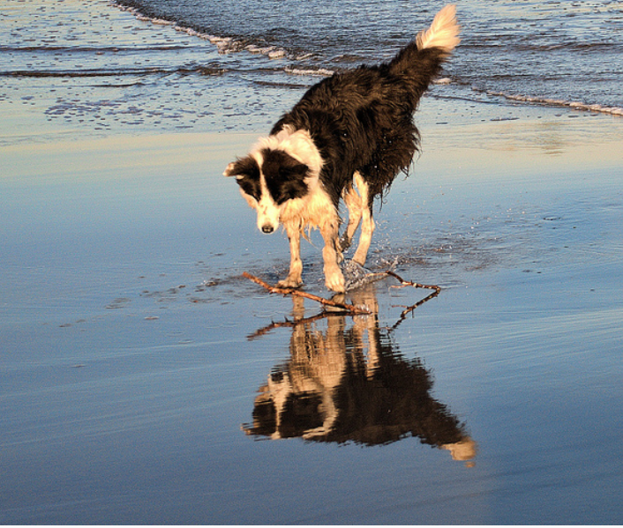
Computer Graphics vs Computer Vision
Computer
Graphics
A double decker bus is
floating on a lake
Computer Vision
A dog is running across
the beach

